Slide 1
Enumerations, Auto boxing and Annotations
Chapter – 2

Slide 2
Enumerations, Auto boxing and Annotations
Enumerations
Java Enumeration are class types
The Values() and ValueOf() Methods
Constructors, methods, instance variables and enumerations
Auto boxing
Annotations (metadata)

Slide 3
Enumerations
An enum is a special class that define a set of constants.
Variables of that type must be equal to one of the constant values that have been predefined.
Example:
public enum Direction { NORTH, SOUTH, EAST, WEST }
public class Triangle { . . . }
Enumeration Constant

Slide 4
Enumerations
Using Enums
e.g:
public enum Season { SPRING , SUMMER , WINTER , FALL }
public static void main(String[ ] args ) {
Season favoriteseason = Season.
}
SPRING
✗
AUTUMN
✓
Math.PI

Slide 5
ENUMERATIONS
Enum vs Class
e.g:
public enum Season {SPRING, SUMMER, FALL, WINTER}
public class Season2{
public static final int SPRING =0;
public static final int SUMMER =1;
public static final int FALL=2;
public static final int WINTER =3;
}
I I I I
0 1 2 3
Java constants are spelled in all
upper-case letters
Enum Constants are implicitly static and final

Slide 6
Java Enumeration are class types
Java implements enumerations are class types.
Enum can’t be instantiate using new, it otherwise acts much like other classes.
Enum can have
Constructor s
Instance variables
Methods
implement interfaces

Slide 7
The Values() and ValueOf() Methods
All enumerations automatically have two pre-defined methods: values( ) and valueOf( ).
The general form:
public static enum_type[ ] values( )
public static enum_type valueOf(String str )
values( ): returns an array that contain a list of the enumeration constants.
valueOf(): method returns the enumeration constant whose value corresponds to the string passed in str

Slide 8
Cont..d
enum Directions { NORTH, SOUTH,WEST, EAST }
class enum1 {
public static void main(String args[]) {
Directions d;
System.out.println(" Here are lists ofconstants");
Directions all[] = Directions.values();
for (Directions a: all)
System.out.println(a);
d = Directions.valueOf(“SOUTH");
System.out.println("Value is:" + d);
}
}

Slide 9
Constructors, methods, instance variables and enumerations
enum Car {
lamborghini(900),tata(2),audi(50),fiat(15),honda(12);
private int price;
Car(int p) { price = p; }
int getPrice() { return price; }
}
public class Main {
public static void main(String args[])
{
System.out.println("All car prices:");
for (Car c : Car.values())
System.out.println( c + " costs " + c.getPrice() + " thousand dollars."); }
}

Slide 10
Cont..d
Restrictions
Cannot inherit another class
Cannot be super class

Slide 11
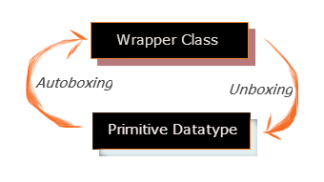
Autoboxing
The automatic conversion of primitive data types into its equivalent Wrapper type is known as boxing
Opposite operation is known as unboxing.
This is the new feature of Java5.

Slide 12
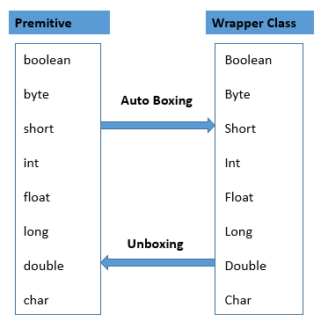
Cont..d
Advantage
No need of conversion between primitives and Wrappers manually so less coding is required.

Slide 13
Cont..d
class AutoBox{
public static void main(String[] args){
Integer iob =100; //autobox an int
int i =iob; //auto –unbox
System.out.println(i + “ “ + iob); // displays 100 100
}
}

Slide 14
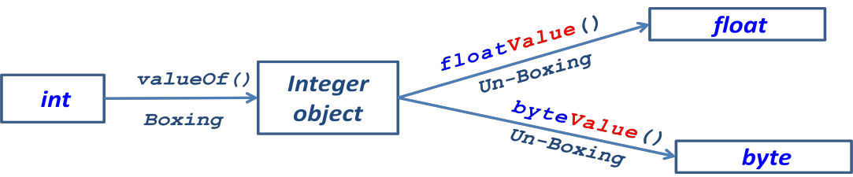
Boxing: Box it in the object of Wrapper class using valueOf() method
UnBoxing: Apply respective method and Unwrap to required type

Slide 15
Annotations
Java annotations is a tag represents the metadata i.e attached with class, interface, method, or fields to indicate some additional information which can be used by java compiler and JVM.
Built-in Java Annotations
@Override
@SuppressWarnings
@Deprecated

Slide 16
Creating Annotations
class Animal{
void eatSomething() { System.out.println("eating something"); }
}
class Dog extends Animal{
@Override
void eatsomething(){
System.out.println("eating foods");
}
}
class TestAnnotation1{
public static void main(String args[]){
Animal a=new Dog();
a.eatSomething();
}
}

Slide 17
Cont..d
@Override
@Override annotation assures that the subclass method is overriding the parent class method. If it is not so, compile time error occurs.
Sometimes, we does the silly mistake such as spelling mistakes etc. So, it is better to mark @Override annotation that provides assurity that method is overridden.

